Slide 1
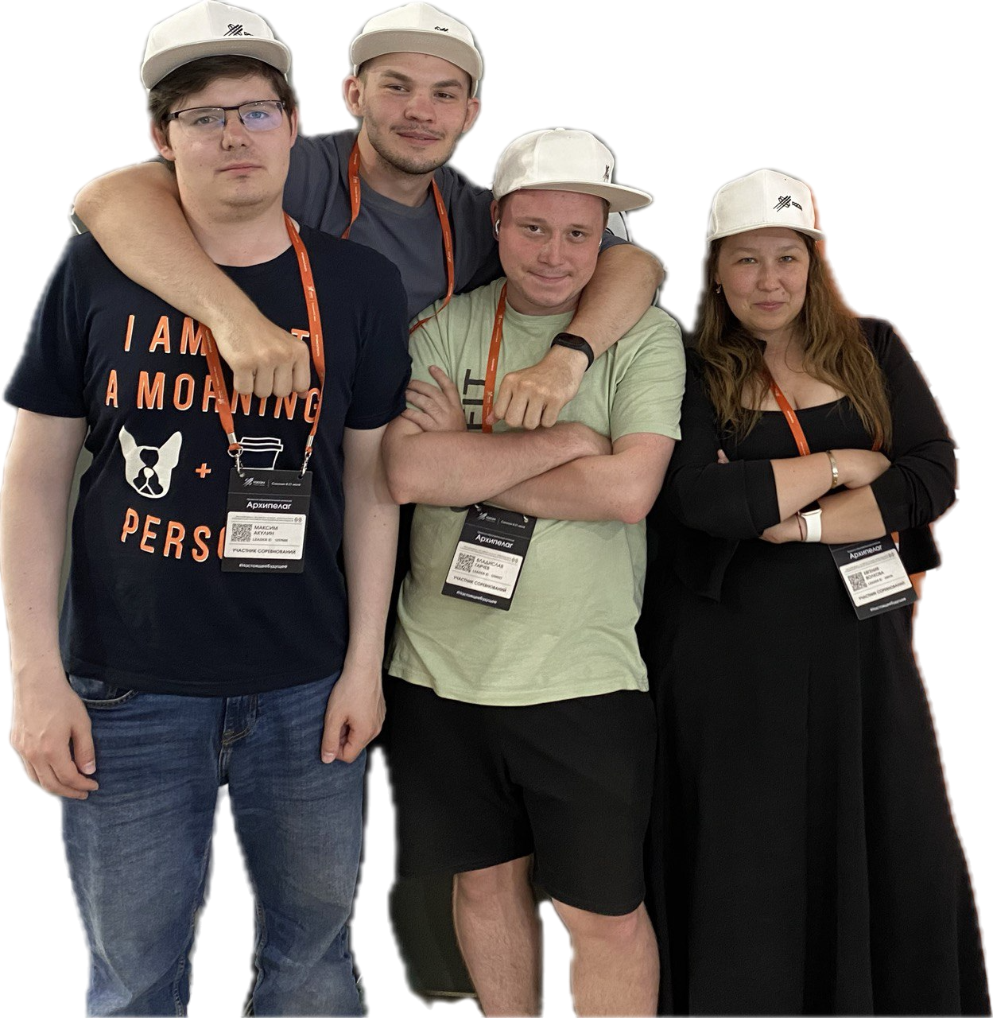

Development of a system for autonomous movement of a rover on public roads in cooperation with a drone

Slide 2
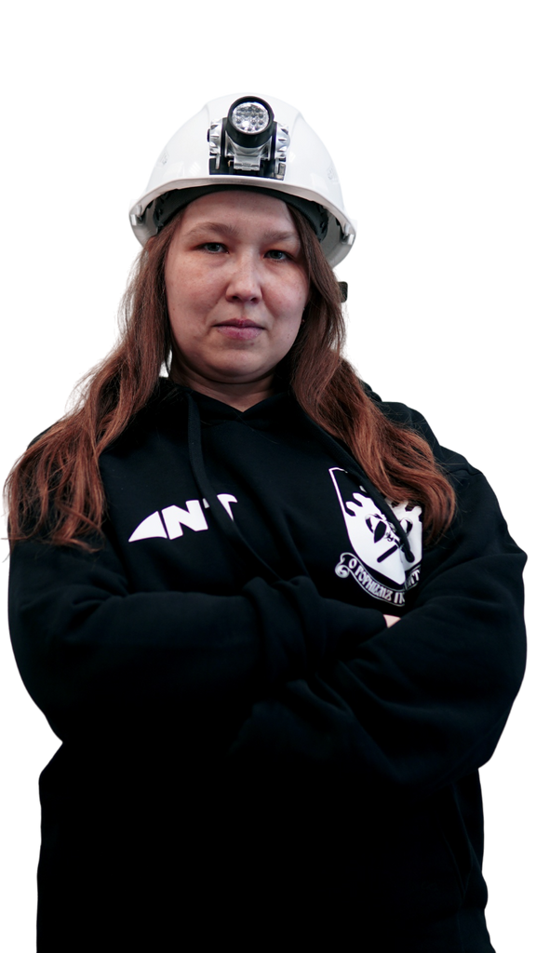
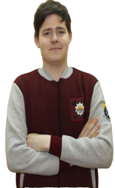
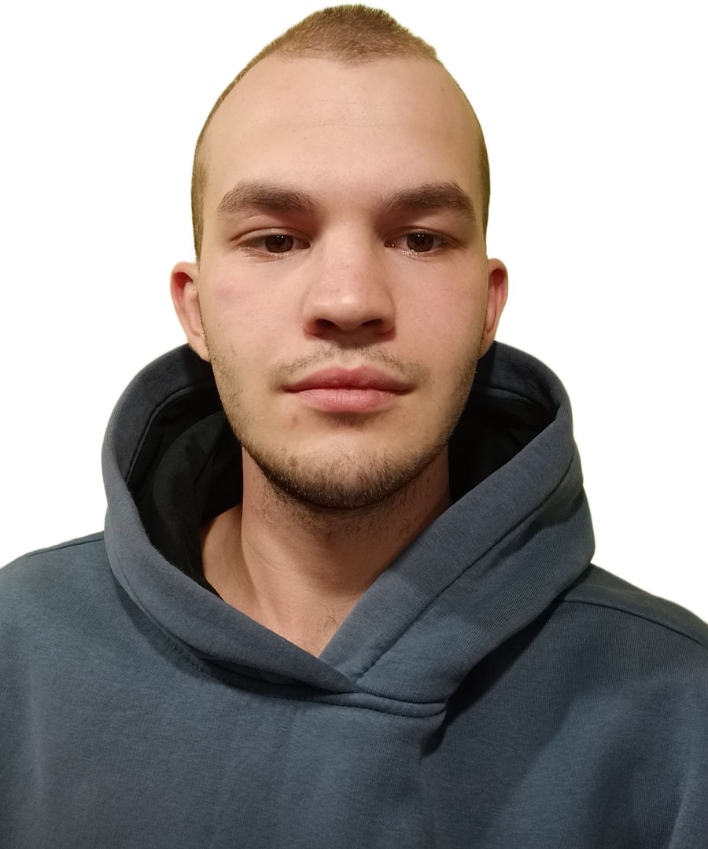
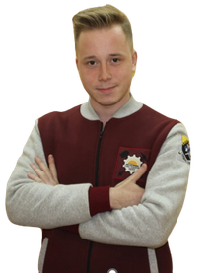
Evgeniya Volkova
Maxim Akulin
Nikita Ermakov
Vladislav Garchev
Teamleader
Drone system architecture & programming
Computer Vision & Machine Learning
Drone programming, firmware and OS

Slide 3
Solution features:
Drone following a rover.
Rover moving along a route.
Rover stopping on command from the drone.
Rover & drone identifying signs and traffic lights.
Drone detecting traffic violations.

Slide 4
Technology stack:
Gazebo, Ardupilot, Python, YOLO8, ROS, OpenCV
Made for drone Clover.Code

Slide 5
Killer features:
consistent recognition of road signs and traffic lights using trained Yolo8 models
interaction between a rover and a drone
huge Gazebo world

Slide 6
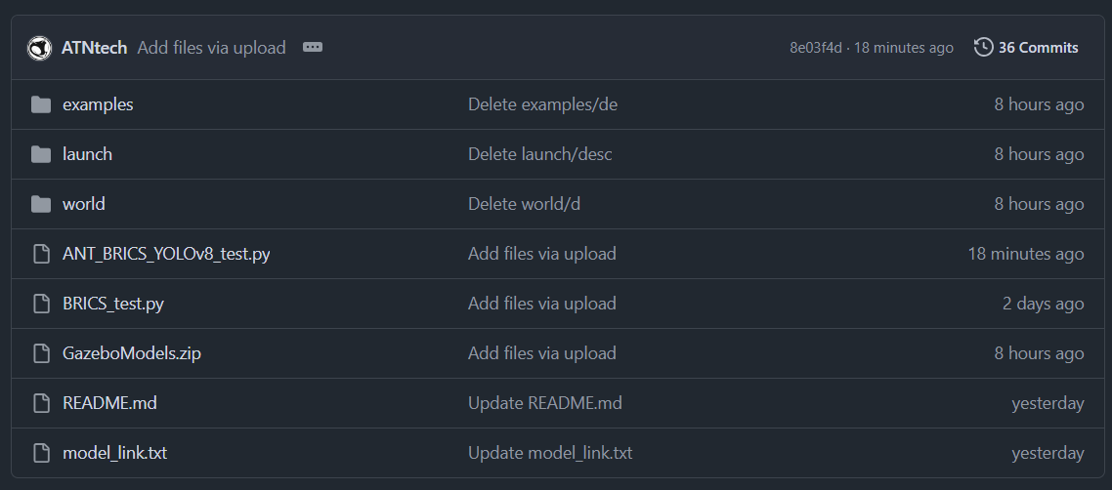
Project structure:

Slide 7
Yolo8 traffic recognition:

Slide 8
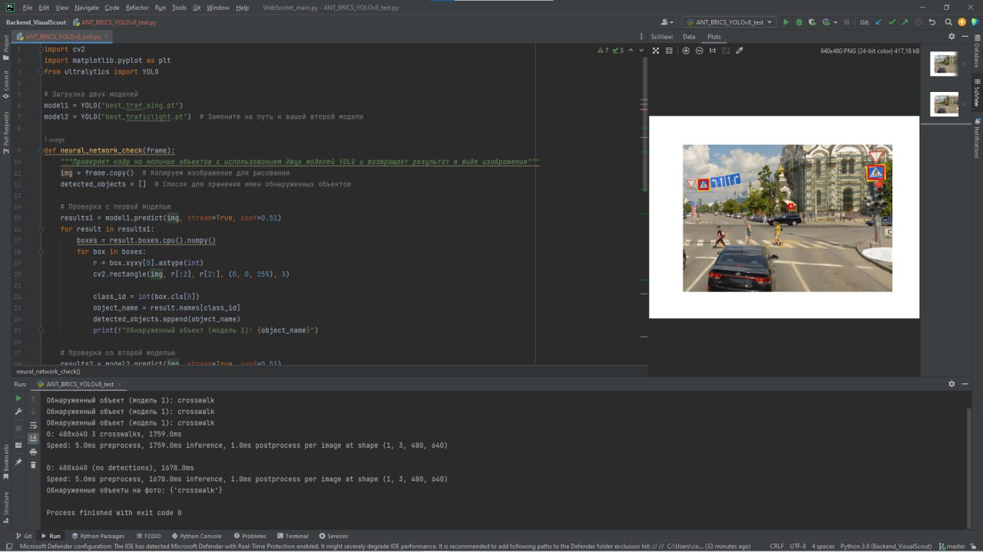

Slide 9
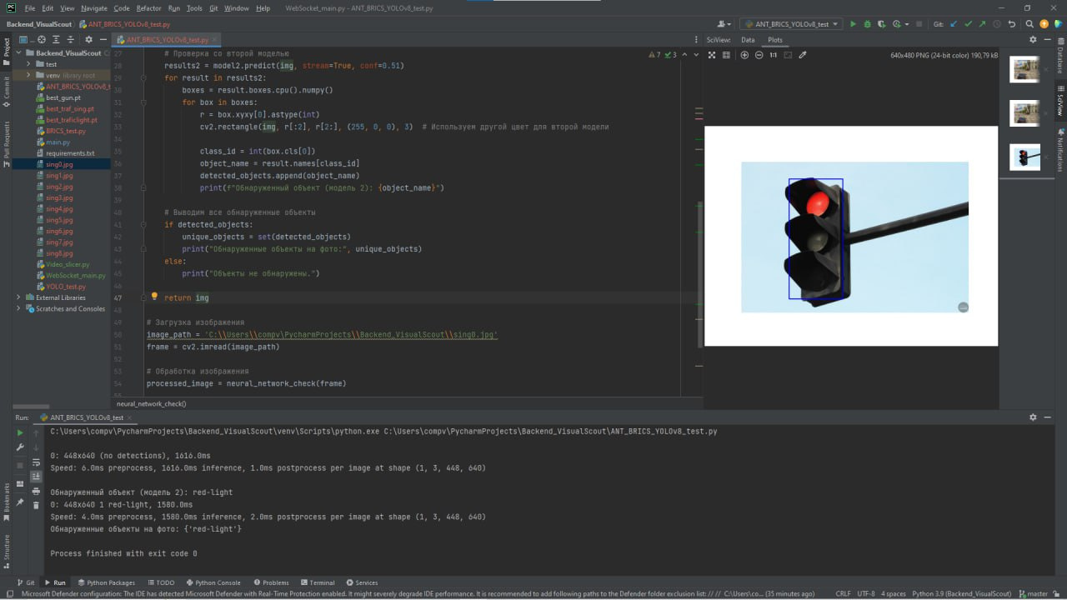

Slide 10
Huge Gazebo world:

Slide 11
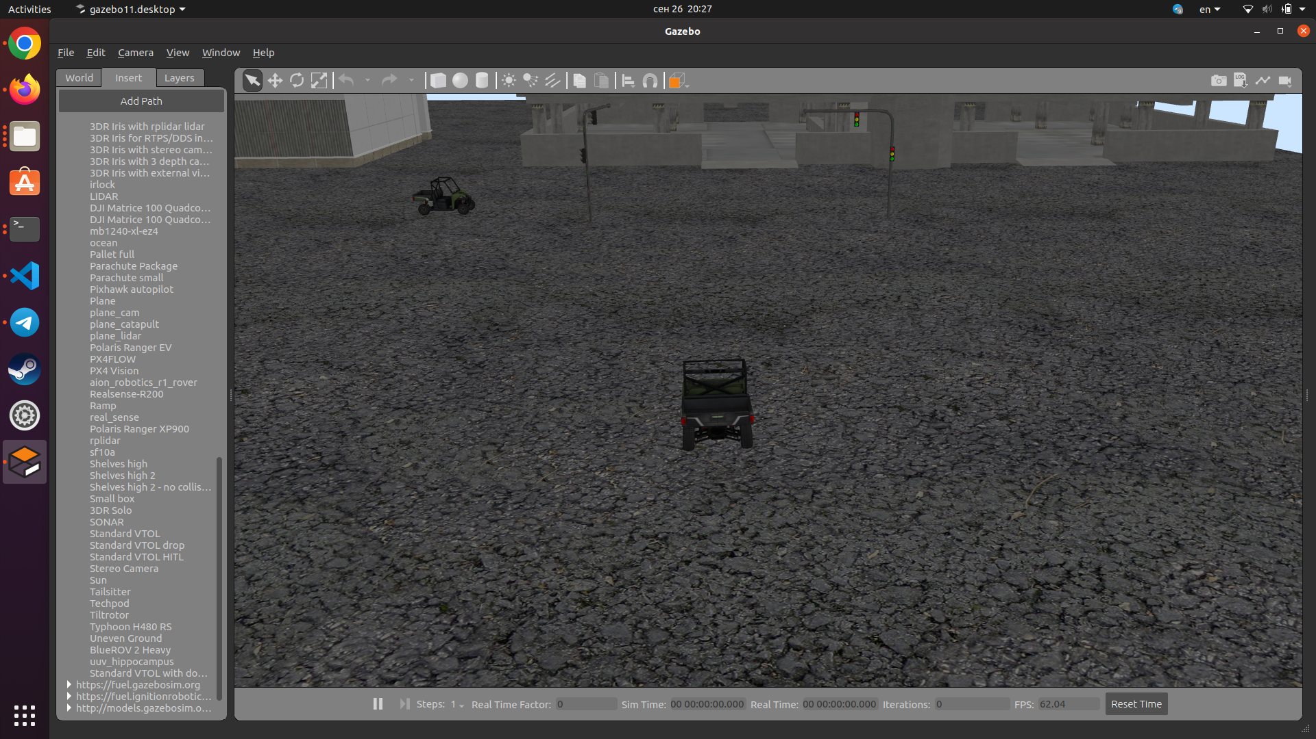

Slide 12
Video demonstation:

Slide 13
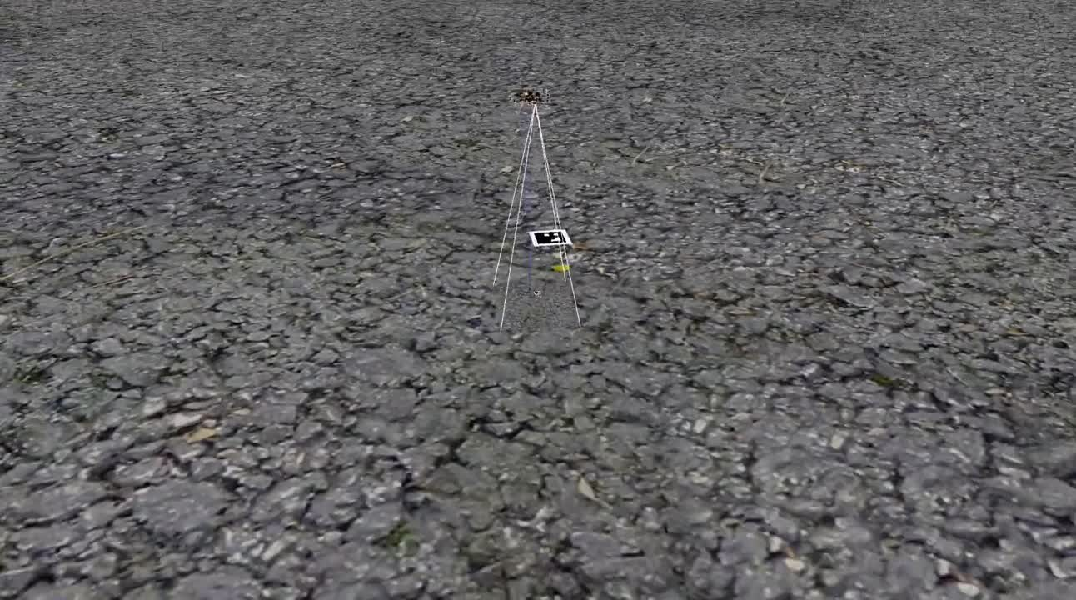

Slide 14
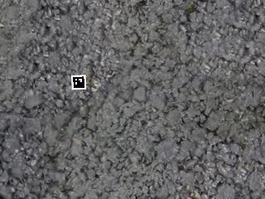

Slide 15
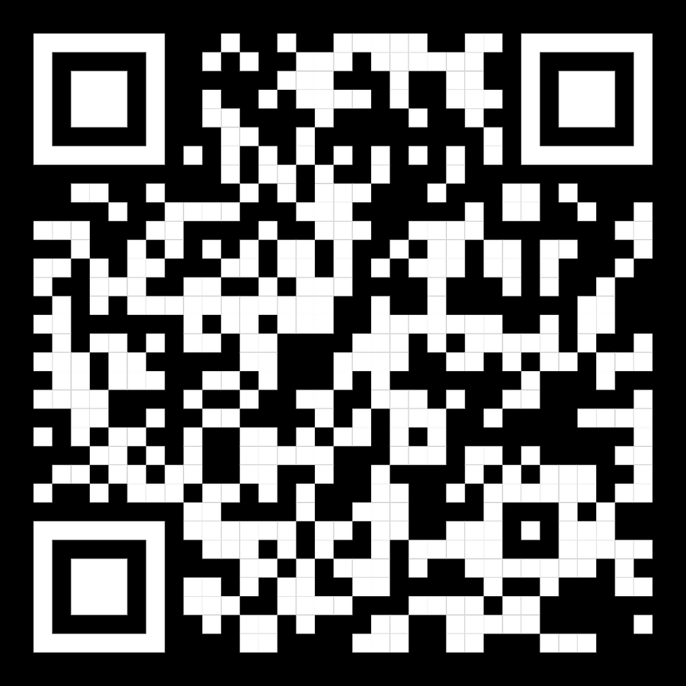
Project link:
https://github.com/ATNtech/BRICS
Documentation:
https://github.com/ATNtech/BRICS/blob/main/README.md

